Slide 1
iMOVE PhD student – ITS Australia NextGens: Fireside chats
Modelling impact of traffic disruptions using integrated Deep Learning and simulation
Artur Grigorev, PhD student FEIT, University of Technology Sydney
20/10/2022
Notes:
Introduction of speaker and title of project

Slide 2
Introduction
Artur Grigorev (3rd year PhD student)
Research topic: Modelling impact of traffic disruptions using integrated Deep Learning and simulation
Supervisors: Adriana-Simona Mihaita, Seunghyeon Lee, Fang Chen
University of Technology Sydney
Associated supporting institutions: ARC Linkage, iMove
Notes:
Student name
PhD topic
PhD supervisor(s)
Associated institutions who are supporting it

Slide 3
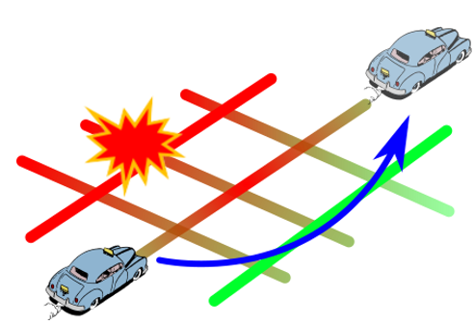
Background of my research
What drives this research
The annual economic cost of road crashes in Australia was estimated at $27 billion per annum in 2017 [1]. But there is also a hidden effect – time lost due to congestion.
Traffic management agencies collect real time data on traffic conditions, traffic accident reports and their characteristics. Amount and complexity of this data becomes beyond human capabilities to analyze. That is why we need to rely on Artificial Intelligence.
The research is about prediction of how long incident-related congestion will last, which impact it will have on traffic flow. All this is to give a final user an advice - when and which route to travel to mitigate the incident impact.
The response of traffic operation agencies can also be simulated to determine the best actions to reduce impact of incidents on traffic flow. 1) https://infrastructure.gov.au/roads/safety/
Notes:
What drives this research
What sector
What problem are you solving
Background context
Important factors or drivers

Slide 4
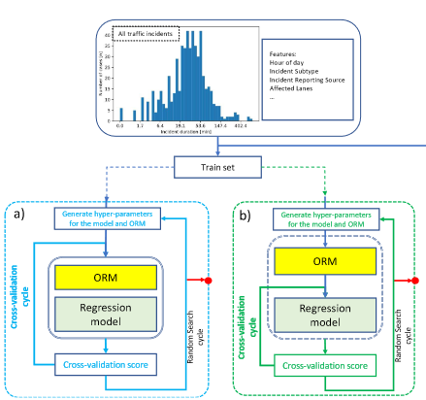
Key Findings research
Progress
Traffic Incident Duration Prediction framework
Traffic disruption detection and segmentation methodology
Incident modelling improvement from using incident description
Traffic incident impact measurement, analysis and prediction
Key Findings
Data-driven incident analysis is relevant to incident reporting
Incident reports are misaligned with observed disruptions, but we can fix it
Computer Vision works very well for traffic incident modelling
Approaches
Machine Learning
Deep Learning
Traffic Simulation
Notes:
What did have you found and how did you find it. How close are you to completing or being confident of your conclusions . Briefly describe the approaches to address your research question in ways that might be clear to someone who has not heard of your topic. How far along are you and what have you found out, the Key findings.
You will need to think carefully about what you think the key points are for your audience or non-technical experts, perhaps in the broader scope of your original research question and problem to solve.

Slide 5
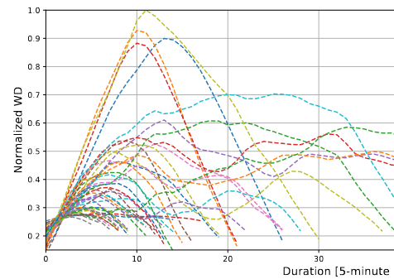
Research project structure
Stage 1
Traffic incident duration and severity prediction (based on traffic flow parameters and incident log datasets)
Stage 2
- Spatial-temporal incident impact estimation (including estimation of spatial-temporal lifecycle of disruption) - Detection of traffic incidents from traffic flow
Stage 3
Simulation-based modelling for response plan and incident clearance strategy.
Notes:
What did have you found and how did you find it. How close are you to completing or being confident of your conclusions . Briefly describe the approaches to address your research question in ways that might be clear to someone who has not heard of your topic. How far along are you and what have you found out, the Key findings.
You will need to think carefully about what you think the key points are for your audience or non-technical experts, perhaps in the broader scope of your original research question and problem to solve.

Slide 6
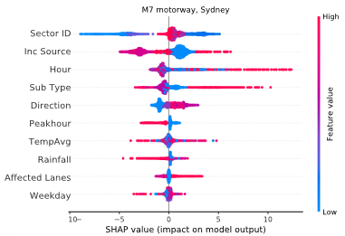
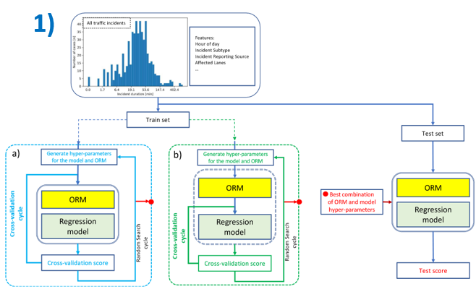
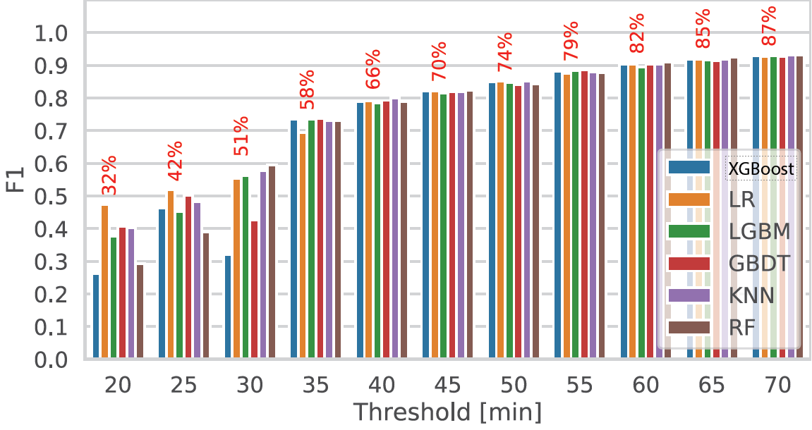
Research outcome #1
Topic: Evaluation of the best and state-of-the-art methods of Deep Learning and Machine Learning, different data analysis approaches on the task of traffic incident analysis to propose a framework that improves the traffic accident duration prediction accuracy.
Journal paper: A.Grigorev, A-S Mihaita, S. Lee, F. Chen,
Incident duration prediction using a bi-level machine learning framework with outlier removal and intra–extra joint optimisation,
Transportation Research Part C: Emerging Technologies, Volume 141, 2022

Slide 7
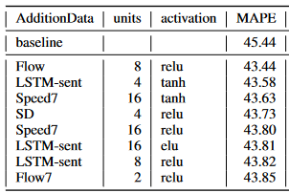
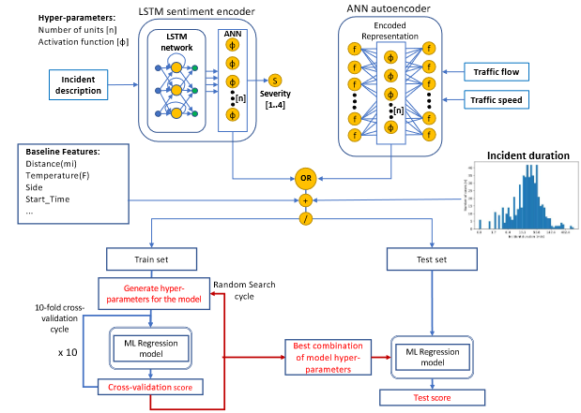
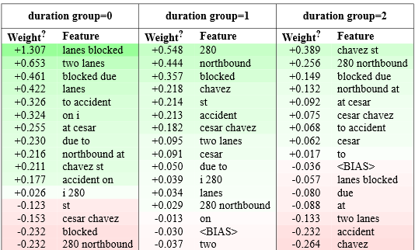
Research outcome #2
Topic: Incorporation of the textual traffic incident description into traffic accident duration prediction models using Natural Language Processing techniques.
Proposition of the framework for incident description and traffic flow/speed data encoding for the incident modelling.
Conference paper: Grigorev, A., Mihaita, A.S., Saleh. K, Picardi, M., Traffic incident duration prediction via a deep learning framework for text description encoding, IEEE Itelligent Transport Systems Conference 2022, Macao, China, 2022.

Slide 8
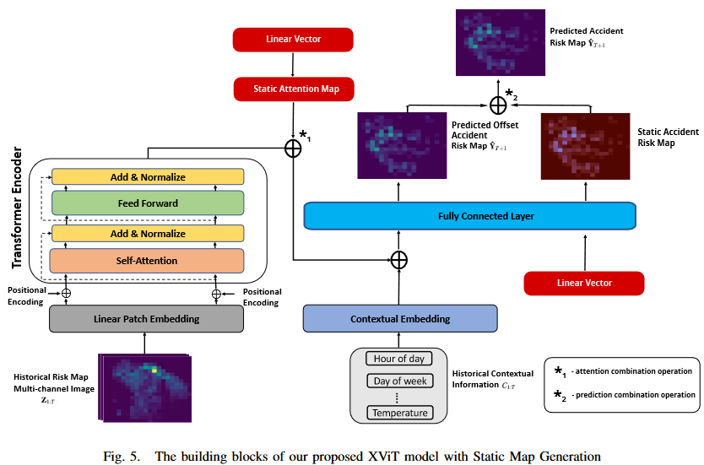
Research outcome #3, #4
Topic: The task of spatial-temporal forecasting reformulated as a computer vision problem. Method tested on the topic of traffic accident risk prediction.
Introduction of static attention and risk maps to outperform SoTA models.
Conference paper: Aboufarw, K.S., Grigorev, A., Mihaita, A.S., Traffic accident risk forecasting using Vision Transformers, IEEE Itelligent Transport Systems Conference 2022, Macao, China, 2022.
Conference (submitted) paper: Grigorev, A., Aboufarw, K.S., Mihaita, A.S., Traffic Accident Risk Forecasting using Contextual Vision Transformers with Static Map Generation

Slide 9
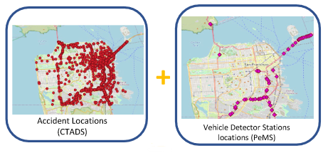
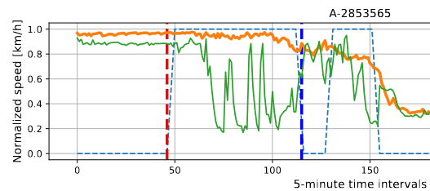
Research outcome #5
Topic:
Detection, segmentation and extraction of observed disruptions in the traffic speed and association with traffic accident reports.
Purpose: Incident impact analysis with precision.
Corrected incident durations.
Conference (accepted) paper: Grigorev, A., Mihaita, A.S., Saleh, K., Chen, F., The Integrated Analysis of Accident Reports and Traffic Flow Data Sets With Early Traffic Disruption Detection and Segmentation, TRB 2023, Washington D.C.

Slide 10
Future plans and vision
Notes:
What does your PhD mean for the future, how will and might the outcomes be used. How might your PhD outcomes improve the sector.
You can be conservative and talk about immediate impact but perhaps then be a bit bolder and imaginative, think in terms of the 5, 20, 50 year timelines! Who will benefit and how? How might this new knowledge develop in the sector and change lives? How might this new knowledge be useful in other sectors?
Are there any questions?

Slide 11
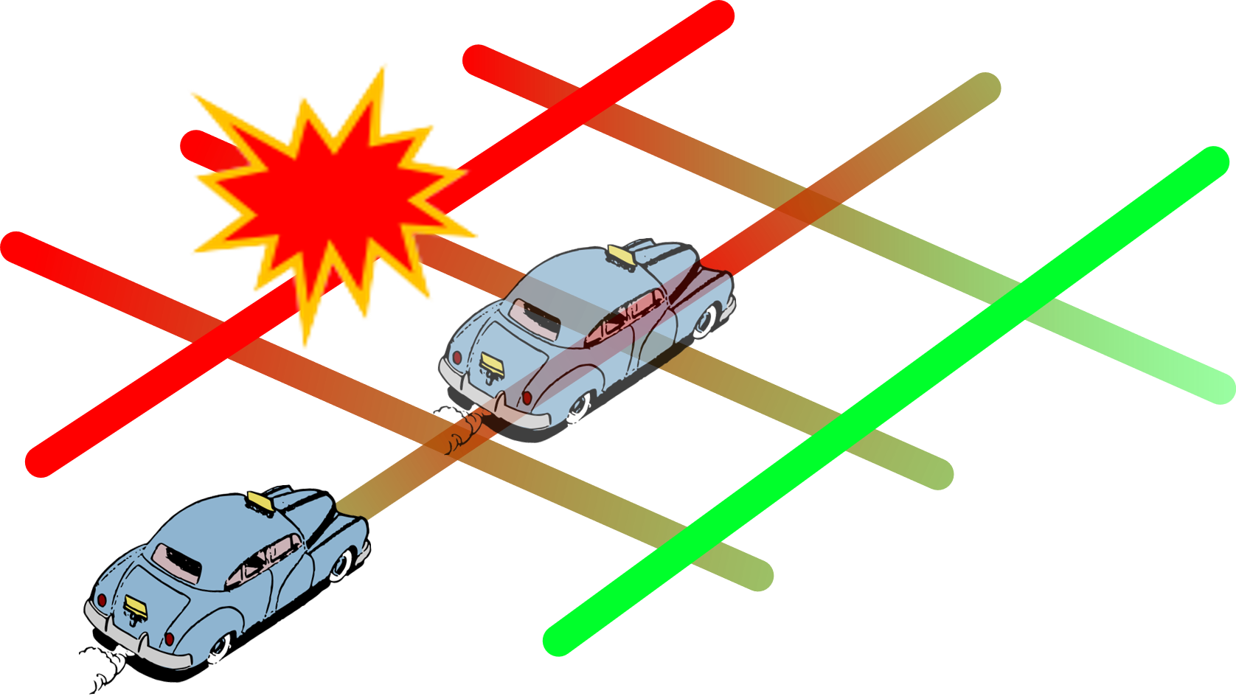
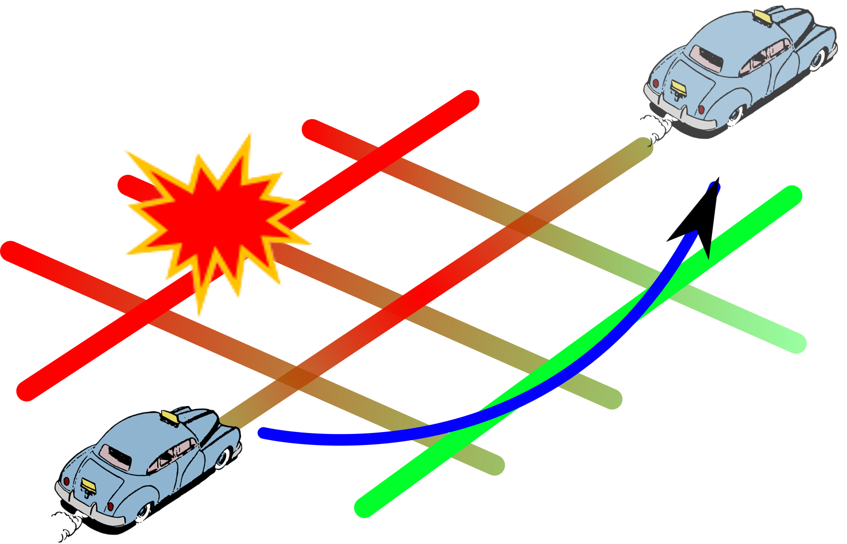
Future Planresearch
The shortest path is not the fastest due to the incident impact
Avoid Predicted Accident Impact
✘
✓

Slide 12
Future Planresearch
Integration of spatial-temporal prediction models and traffic simulation
Avoid Predicted Accident Impact
✘
✓

Slide 13
Presenter: Artur.Grigorev@student.uts.edu.au
University of Technology Sydney, Building 02, Level 12
+61 466 870 224
http://fmlab.org

