Slide 1
Automated Traffic Accident Detection, Segmentation and Duration Prediction
Artur Grigorev (3rd year PhD student, FEIT, UTS)
Artur.Grigorev@student.uts.edu.au

Slide 2
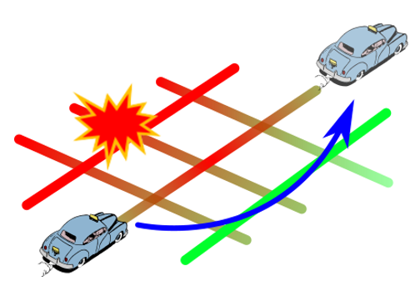
Introduction
What drives this research
The annual economic cost of road crashes in Australia was estimated at $27 billion per annum in 2017 [1]. But there is also a hidden effect – time lost due to congestion.
Traffic management agencies collect real time data on traffic conditions, traffic accident reports and their characteristics. Amount and complexity of this data becomes beyond human capabilities to analyze. That is why we need to rely on Artificial Intelligence.
The research is about prediction of how long incident-related congestion will last, what impact it will have on traffic flow. All this is to give a final user an advice - when and which route to travel to mitigate the incident impact. 1) https://infrastructure.gov.au/roads/safety/
Notes:
What drives this research
What sector
What problem are you solving
Background context
Important factors or drivers

Slide 3
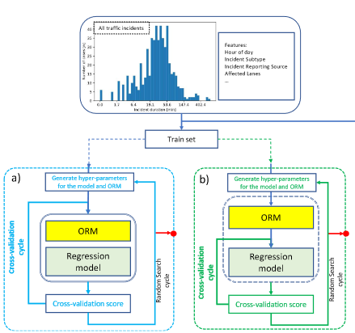
Key Findings research
Progress
Traffic Incident Duration Prediction framework
Traffic disruption detection and segmentation methodology
Traffic incident impact measurement, analysis and prediction
Key Findings
Data-driven incident analysis can improve the incident reporting
Incident reports are misaligned with observed disruptions, but we can fix it
Computer Vision methods work very well for traffic incident modelling
Approaches
Machine Learning
Deep Learning
Traffic Simulation
Notes:
What did have you found and how did you find it. How close are you to completing or being confident of your conclusions . Briefly describe the approaches to address your research question in ways that might be clear to someone who has not heard of your topic. How far along are you and what have you found out, the Key findings.
You will need to think carefully about what you think the key points are for your audience or non-technical experts, perhaps in the broader scope of your original research question and problem to solve.

Slide 4
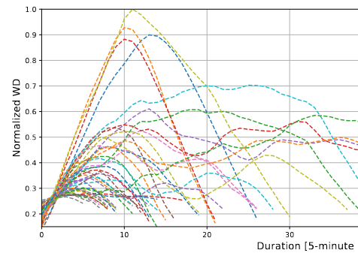
Research project structure
Stage 1
- Traffic incident duration and severity prediction (based on incident log datasets, incident description and traffic flow parameters)
Stage 2
- Spatial-temporal incident impact estimation (including estimation of spatial-temporal lifecycle of disruption) - Detection of traffic incidents from traffic flow
Stage 3
Simulation-based modelling for response plan and incident clearance strategy.
Notes:
What did have you found and how did you find it. How close are you to completing or being confident of your conclusions . Briefly describe the approaches to address your research question in ways that might be clear to someone who has not heard of your topic. How far along are you and what have you found out, the Key findings.
You will need to think carefully about what you think the key points are for your audience or non-technical experts, perhaps in the broader scope of your original research question and problem to solve.

Slide 5
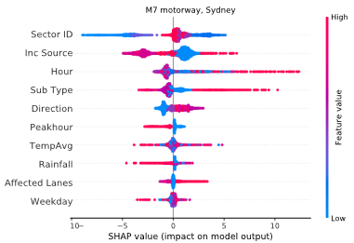
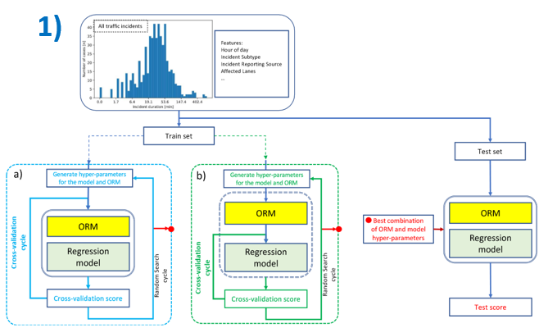
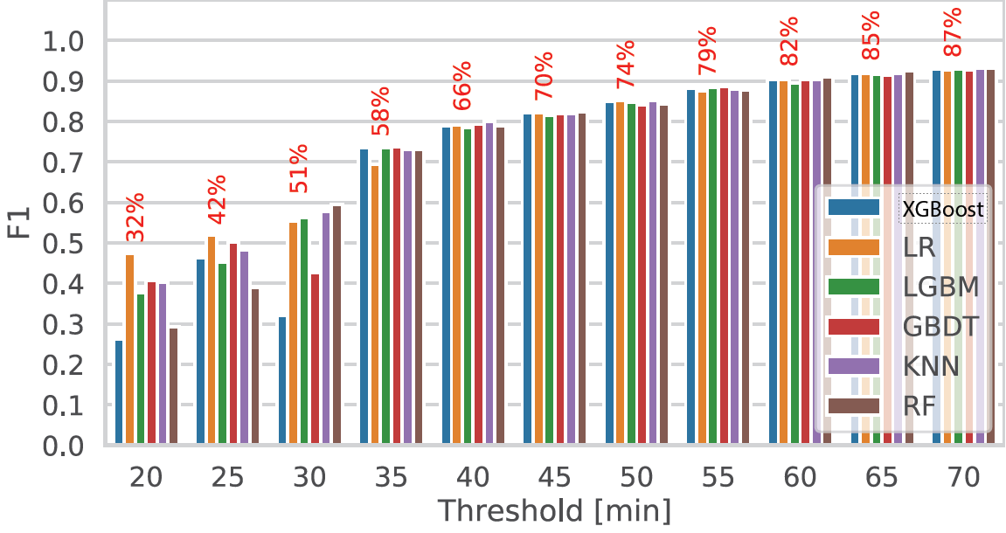
Outcome #1 Traffic Incident Duration modelling
3)
Topic: Evaluation of the best and state-of-the-art methods of Machine Learning, various data analysis approaches on the task of traffic incident modelling to propose a framework that improves the traffic accident duration prediction accuracy.
Classification and regression, 6 ML models, 3 data sets, feature importance estimation, ensemble learning.
2)
Journal paper: A.Grigorev, A-S Mihaita, S. Lee, F. Chen,
Incident duration prediction using a bi-level machine learning framework with outlier removal and intra–extra joint optimisation,
Transportation Research Part C: Emerging Technologies, Volume 141, 2022
Notes:
Threshold, feature importance, framework

Slide 6
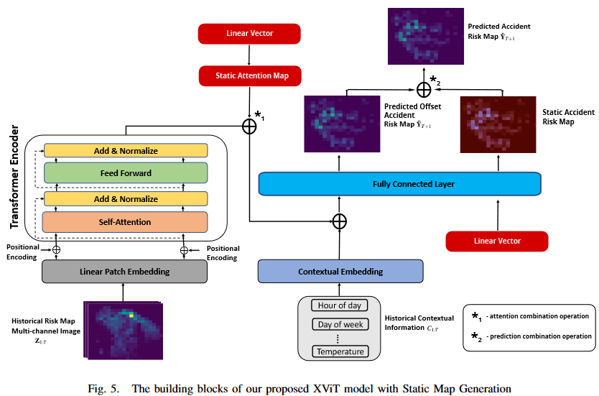
Outcome #2 Traffic Accident Risk Prediction
Topic: 1) The task of spatial-temporal forecasting reformulated as a computer vision problem. The method tested on the topic of traffic accident risk prediction.
2) Introduction of static attention and static risk maps to outperform SoTA ViT model.
Conference paper: Aboufarw, K.S., Grigorev, A., Mihaita, A.S., Traffic accident risk forecasting using Vision Transformers, IEEE Itelligent Transport Systems Conference 2022, Macao, China, 2022.
Conference (submitted) paper: Grigorev, A., Aboufarw, K.S., Mihaita, A.S., Traffic Accident Risk Forecasting using Contextual Vision Transformers with Static Map Generation

Slide 7
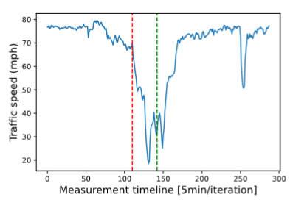
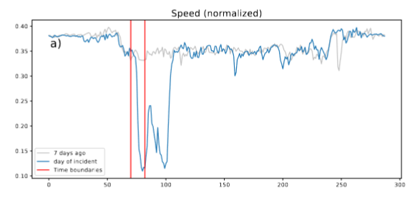
Why detect traffic accidents?

Slide 8
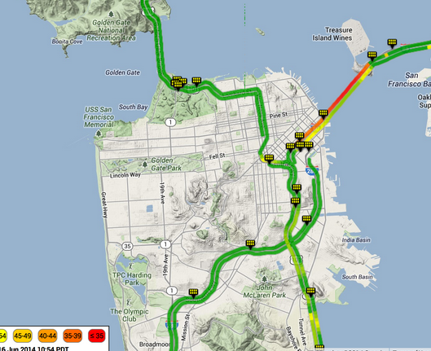
PeMS - vehicle detector data (speed, flow, occupancy)
To collect the data on traffic flow and speed we rely on the Caltrans Performance Measurement System (PeMS), which provides aggregated 5-minute precision measurements of traffic movements across California.
For our study we select the area of San-Francisco, which includes 83 Vehicle Detector Stations (VDS).

Slide 9
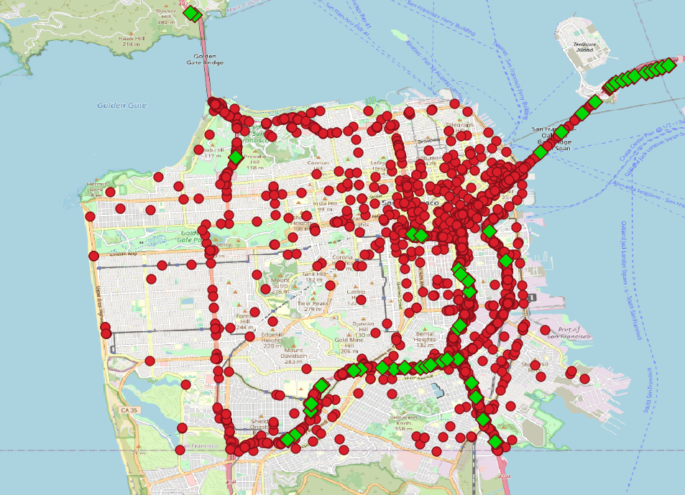
CTADS – accident reports data
Countrywide Traffic Accident Data set (CTADS) contains about 1.5
million traffic accident records across 49 states of United States of America from February 2016 to December 2020.
Each accident report contains 47 features describing the traffic accident.
In total, from 9,275 accidents in the San Francisco area we have obtained 1,932 traffic accident reports in a 500m proximity next to VDS stations (from PeMS data set

Slide 10
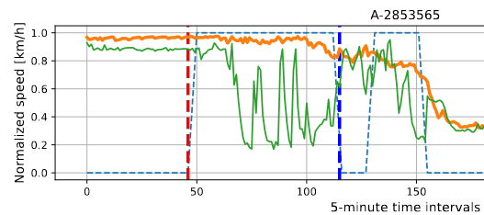
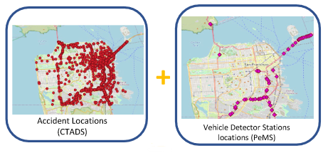
2)
Outcome #3 Traffic Accident Detection and Segmentation PeMS + CTADS
1)
Topic:
Detection, segmentation and extraction of observed disruptions in the traffic speed and association with traffic accident reports.
Purpose: Incident impact analysis with precision.
Corrected incident durations.
Conference (accepted) paper: Grigorev, A., Mihaita, A.S., Saleh, K., Chen, F., The Integrated Analysis of Accident Reports and Traffic Flow Data Sets With Early Traffic Disruption Detection and Segmentation, TRB 2023, Washington D.C.

Slide 11
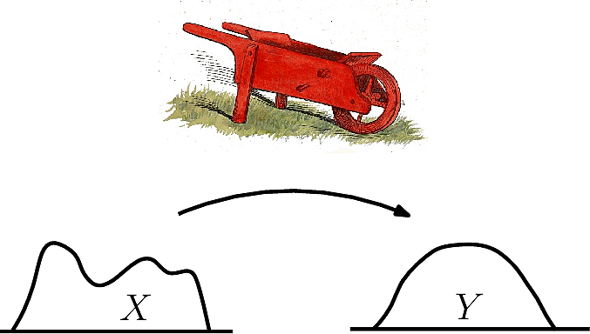
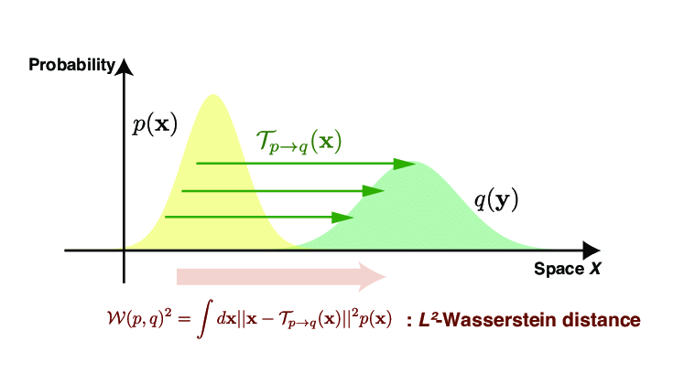
How to measure the traffic incident impact?
Wesserstein Distance – “minimum amount of work necessary to change one shape into another shape”.
Speed/flow impact can be represented as a cumulative difference within time frame.
This difference can be estimated using various metrics. Most fitting to the task is Wasserstein distance, which can be formulated as amount of work produced by traffic incident to alter the traffic state.
Nakazato, Muka & Ito, Sousuke. (2021). Geometrical aspects of entropy production in stochastic thermodynamics based on Wasserstein distance.
^ - metric value normalized at each station separately, among all measurements at this station

Slide 12
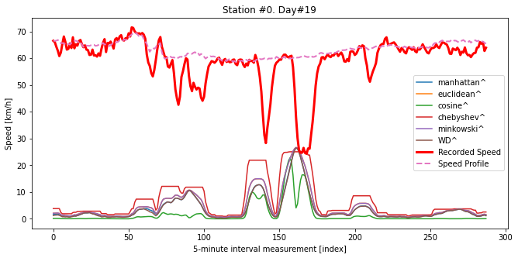
Difference between recorded speed and daily speed profile
The difference estimated using 30 minutes (6 intervals) moving window. The difference calculated can indicate the traffic disruption.
^ - metric value normalized at each station separately, among all measurements at this station

Slide 13
Fundamental speed-flow diagrams with WD coloring (30-minute window)

Slide 14
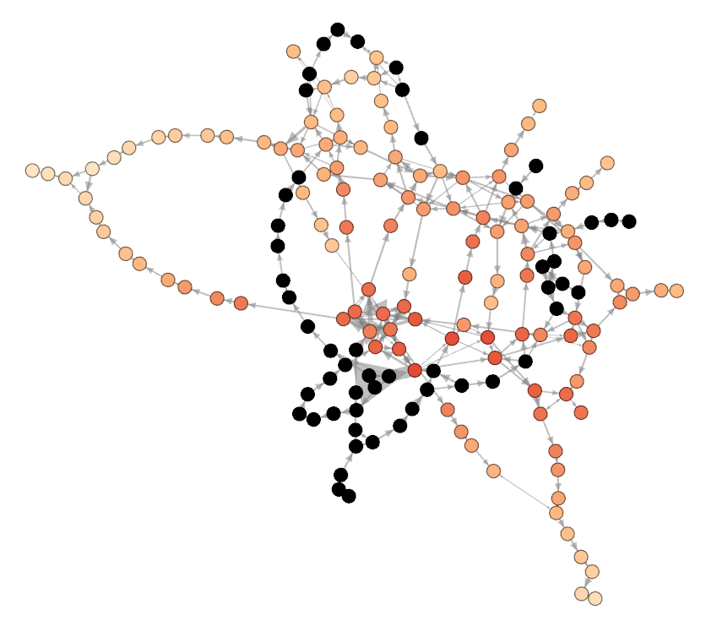
ForceAtlas for PEMS-08 graph representation / animation

Slide 15
The problem of Traffic Incident Impact Prediction. Conventional approach
The task of predicting the impact propagation. How traffic speed on adjacent stations will affect traffic speed at the current station.

Slide 16
Re-formulation of the Traffic Incident Impact Prediction problem
The task of predicting the impact propagation. How changes in the past will create changes in the future.
$$2) ∂S_{i,t}=\int_{t−k}^{t}{\int_{1}^{n}{α_{i}∗∂S_{i,t}}∂t}$$
1) Spatial-temporal impact transmission (first derivative of the speed pred. prob.)
$$\left(\begin{matrix}{∂S}_{0,0} & ⋯ & \\ ⋮ & ⋱ & ⋮ \\ & ⋯ & {∂S}_{i,t+k}\end{matrix}\right)=\left(\begin{matrix}{∂S}_{0,0} & ⋯ & \\ ⋮ & ⋱ & ⋮ \\ & ⋯ & {∂S}_{i,t−k}\end{matrix}\right). \left(\begin{matrix}β_{0,0} & ⋯ & \\ ⋮ & ⋱ & ⋮ \\ & ⋯ & β_{i,t−k}\end{matrix}\right)$$
, $i ∈\{1.. {VDS}_{n}\}$
Speed impact in the future
Speed change in the past
Transmission coefficients
α – transmission coefficient
Si – speed at VDSi
2) Impact (WD) transmission
$$\left(\begin{matrix}{WD}_{0,0} & ⋯ & \\ ⋮ & ⋱ & ⋮ \\ & ⋯ & {WD}_{i,t+k}\end{matrix}\right)=\left(\begin{matrix}{WD}_{0,0} & ⋯ & \\ ⋮ & ⋱ & ⋮ \\ & ⋯ & {WD}_{i,t−k}\end{matrix}\right). \left(\begin{matrix}β_{0,0} & ⋯ & \\ ⋮ & ⋱ & ⋮ \\ & ⋯ & β_{i,t−k}\end{matrix}\right)$$
Since
$$3) WD \sim ∂S_{i}$$
Impacts in the future
Impact in the past
Transmission coefficients

Slide 17
Results for automated disruption segmentation

Slide 18
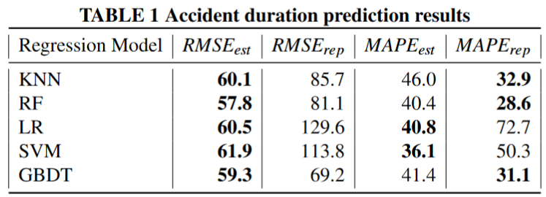
Traffic accident duration prediction results

Slide 19
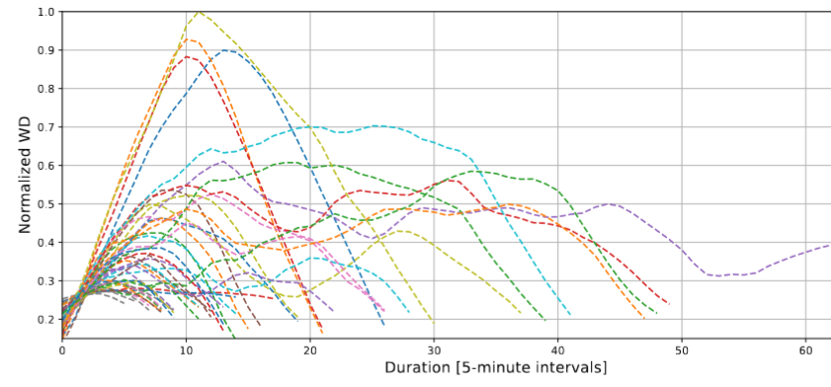
Traffic accidents impact extracted and represented as Normalized WD

Slide 20
Conclusions
Detection of traffic accidents from traffic speed is necessary since accident reports contain timeline errors related to accident start time and duration.
Detection and segmentation of traffic accidents allows for fine-grained analysis of accident impact associated with accident reports.
Amount of the accident impact can also be used as a predicted value, which formulates the problem of speed/flow prediction into the problem of the “prediction of change” in speed/flow due to incident.

Slide 21
Future plans and vision
Notes:
What does your PhD mean for the future, how will and might the outcomes be used. How might your PhD outcomes improve the sector.
You can be conservative and talk about immediate impact but perhaps then be a bit bolder and imaginative, think in terms of the 5, 20, 50 year timelines! Who will benefit and how? How might this new knowledge develop in the sector and change lives? How might this new knowledge be useful in other sectors?
Are there any questions?

Slide 22
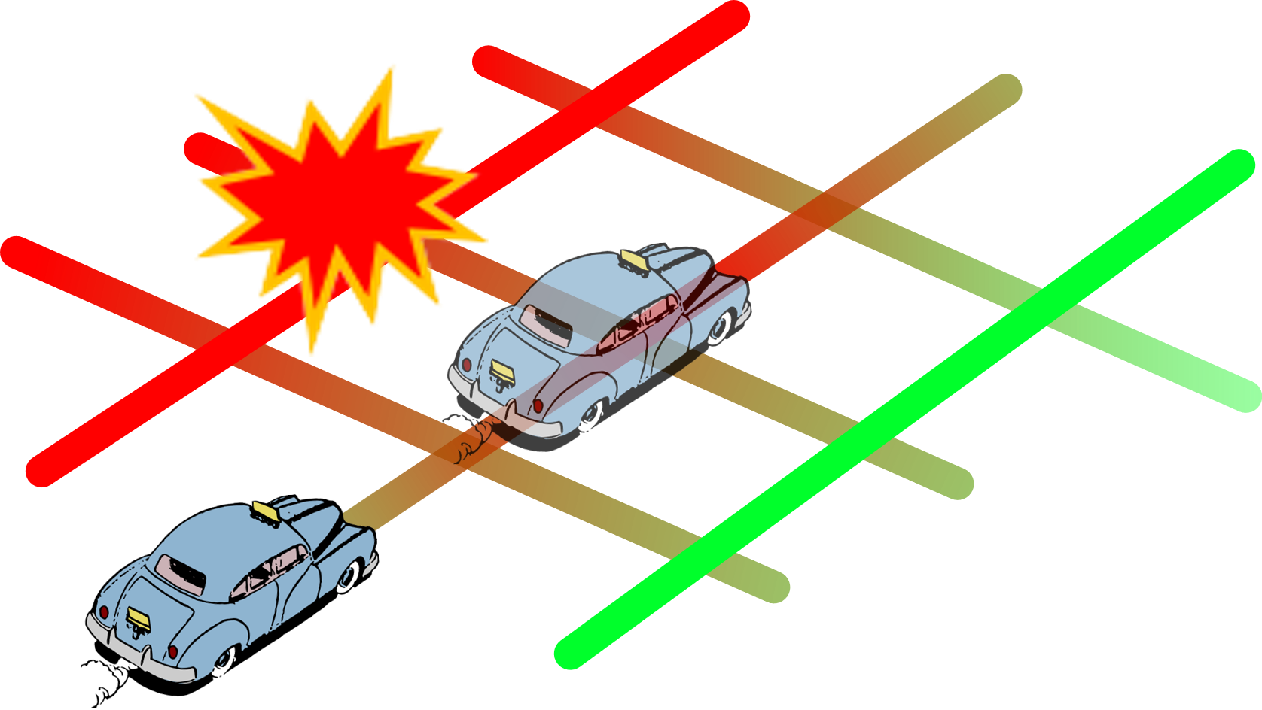
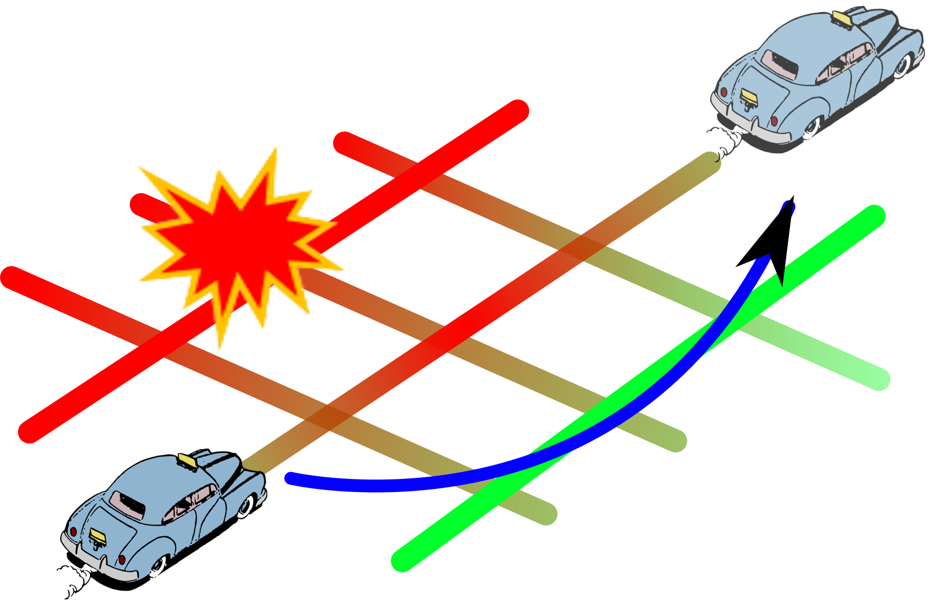
Mobile App to avoid the predicted accident impact
The shortest path affected by the incident impact
Avoid Predicted Accident Impact
✘
✓

Slide 23
Thank You!
Spatial-temporal incident impact analysis. The Traffic Disruption Propagation
Artur Grigorev
Artur.Grigorev@student.uts.edu.au

Slide 24
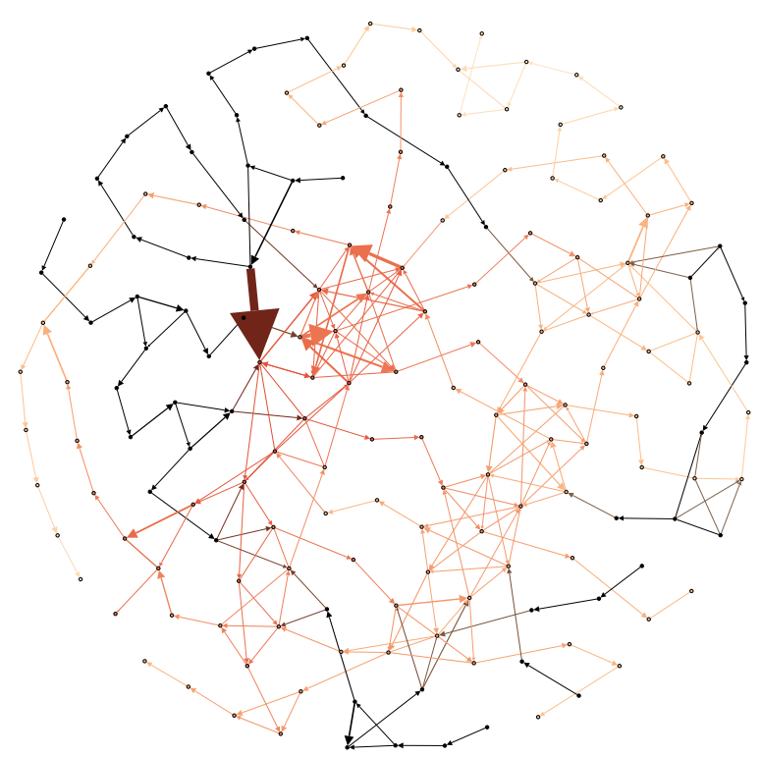
Speed impact propagation
PEMS-08 Road Network
Wesserstein distance
Traffic Speed

Slide 25
Traffic Incident Impact Prediction. Conventional approach
The task of predicting the impact propagation. How traffic speed in the past will affect traffic speed in the future.
$$1) S_{i,t}=\sum{α_{i}∗S_{i,t−k}}$$
, $i ∈\{1.. {VDS}_{n}\}$
1) Spatial-temporal (station-time) speed transmission
$$\left(\begin{matrix}S_{0,0} & ⋯ & \\ ⋮ & ⋱ & ⋮ \\ & ⋯ & S_{i,t+k}\end{matrix}\right)=\left(\begin{matrix}S_{0,0} & ⋯ & \\ ⋮ & ⋱ & ⋮ \\ & ⋯ & S_{i,t−k}\end{matrix}\right). \left(\begin{matrix}α_{0,0} & ⋯ & \\ ⋮ & ⋱ & ⋮ \\ & ⋯ & α_{i,t−k}\end{matrix}\right)$$
α – transmission coefficient
Si – speed at VDSi
Speeds in the future
Speeds in the past
Transmission coefficients

